Slide 1
Online News Popularity
TEAM: DATA DETECTIVES
By: Yeshaswini M(01FB16ECS459)
K Vennela (01FB16ECS481)
Alka Simon (01FB16ECS487)

Slide 2
Problem Statement:
1.Prediction of the popularity of the news article published online
2.Recommending what changes to make in the article to become popular.
Dataset:
https://archive.ics.uci.edu/ml/datasets/online+news+popularity
This dataset summarizes a heterogeneous set of features about articles published by Mashable in a period of two years
It has 39797 instances and 61 attributes.
Nominal features were transformed with one hot encoding.
3 types of keywords-worst,average and best
NLP features-LDA(latent Dirichlet allocation),Title Subjectivity,Title Sentiment Polarity,Rate of positive and Negative words.

Slide 3
Domain Introduction
There has been a growing interest in online news due to enhancement of technology, which allows an easy and fast spread of information. So, if a news becomes popular, it means that it has influenced public. A prediction model like this can help publishers to maximize their profits and sell advertisements.
Popularity prediction is a challenging task because of its difficulty to measure the quality of content and how relevant the content is with respect to the interest of the users.

Slide 4
Data Preprocessing and Exploratory Data Analysis
Removed Outlier and Checked for NA values.
Plotted Graphs to visualize the relation between variables.
PCA Analysis was done. But, we didn’t find it useful.
Stepwise feature selection was done which gave better results.
We used log transformation on the data to make it normally distributed.
This proves why this works better as a classification model as classification involves the log transform.

Slide 5
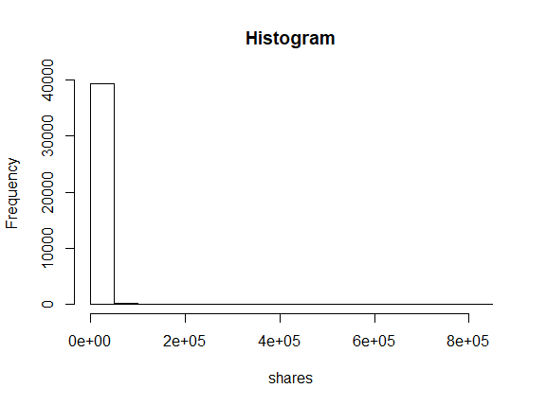
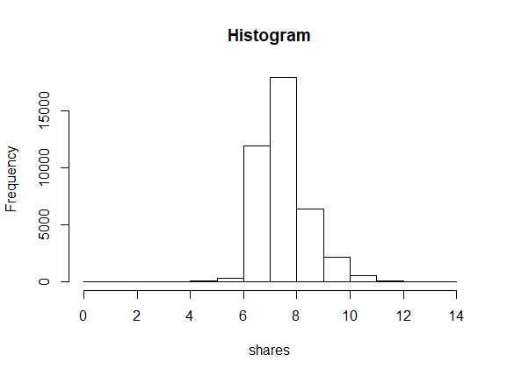
Log Transformation

Slide 6
WORKFLOW
Test data
EDA and feature selection and splitting of data
Training process
Data Preprocessing
Training data
Model
predictions
Recommendation system
Newly recommended point for article to be popular

Slide 7
MODELS USED
We used different models to train our dataset and predict results according to them.
Linear Regression
Logistic Regression
Random Forest
Support Vector Machine(SVM)
Decision Trees
Gradient Boosting Method
We considered the news with shares more than 3rd quartile as popular.

Slide 8
Recommendation System
Calculating the euclidean distance from the test data point to the train data point.
Calculating the centroid of K nearest neighbours to the test data point and suggesting the changes for that data point.

Slide 9
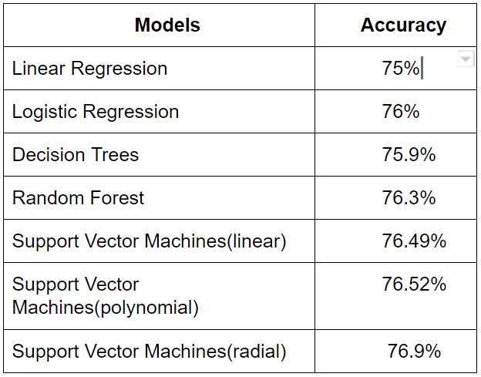
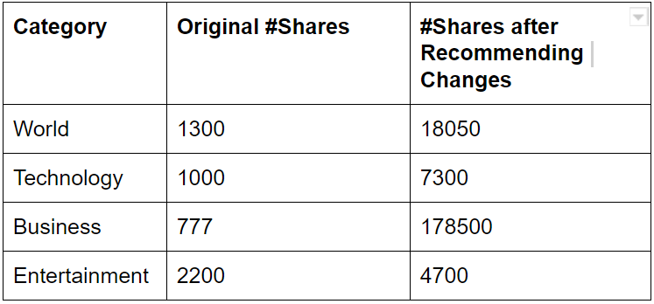
Results and Analysis
The threshold that we took to classify news article as popular or unpopular is the 3rd quartile value which is 2800 number of shares.

Slide 10
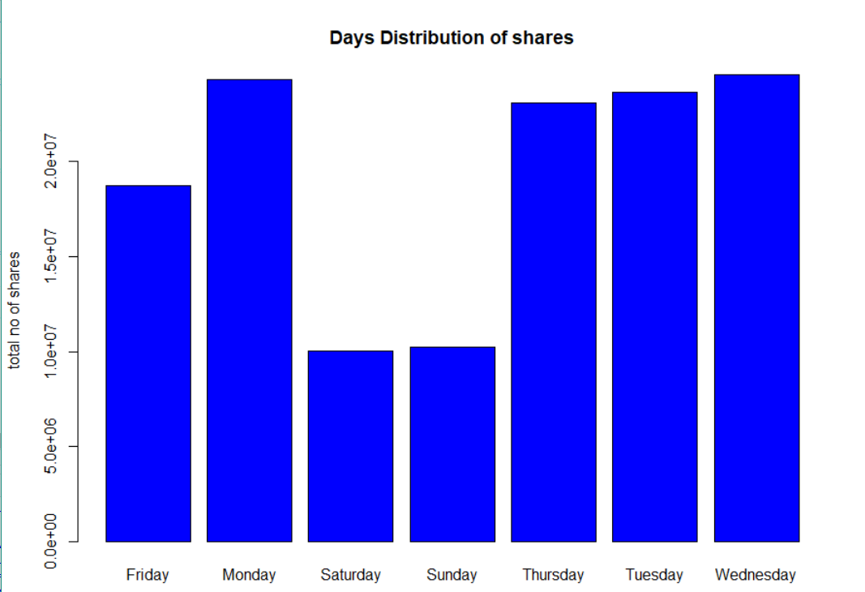
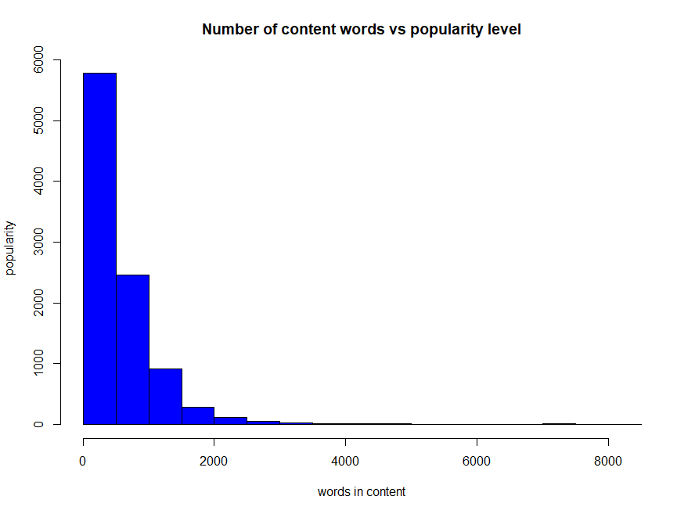
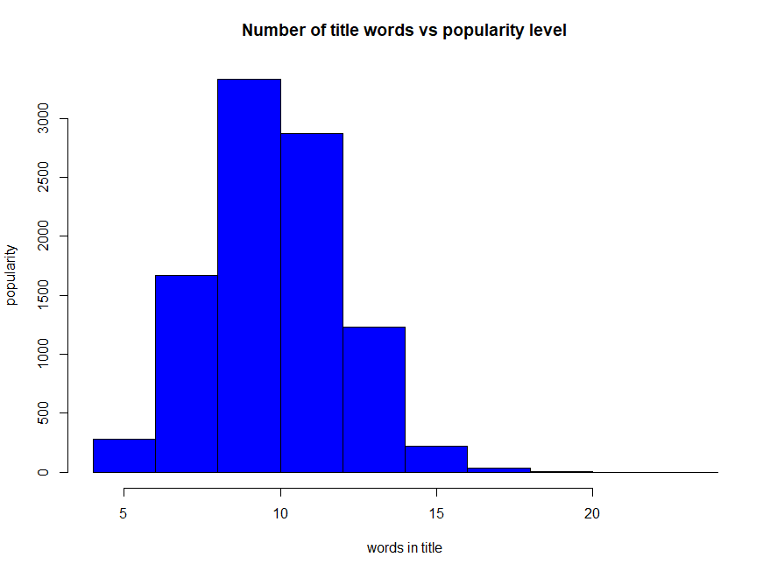
Visualization
We did some visualizations to get some insight of our data. When we plotted total number of shares been done on a weekdays, we could see that shares were less on weekends while more on other days.

Slide 11
Thank you!!!!!!

